Slide 1
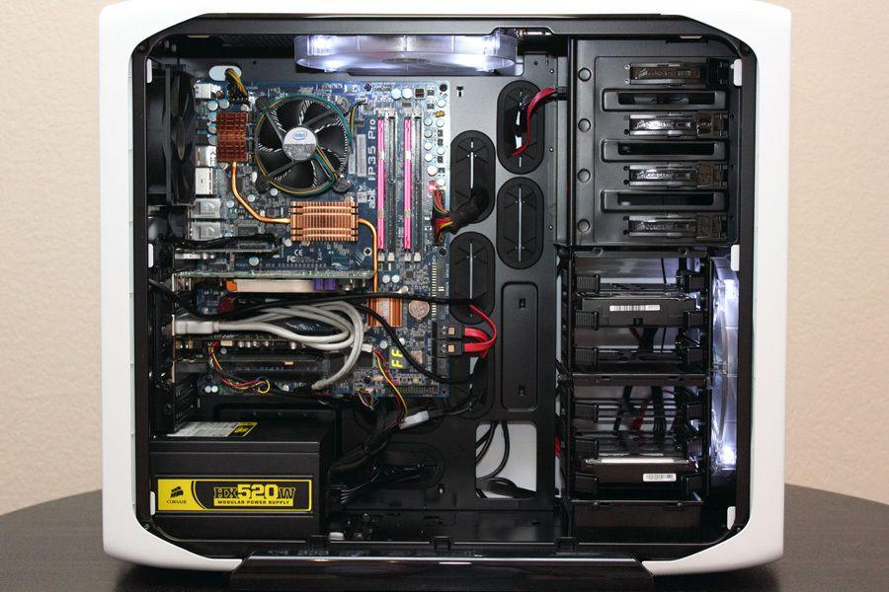
Cooling fan
Motherboard
Audio port
Optical disk drive
Ethernet
Usb expansion port
Monitor Port
Hard Disk Drive
Power
Supply

Slide 2
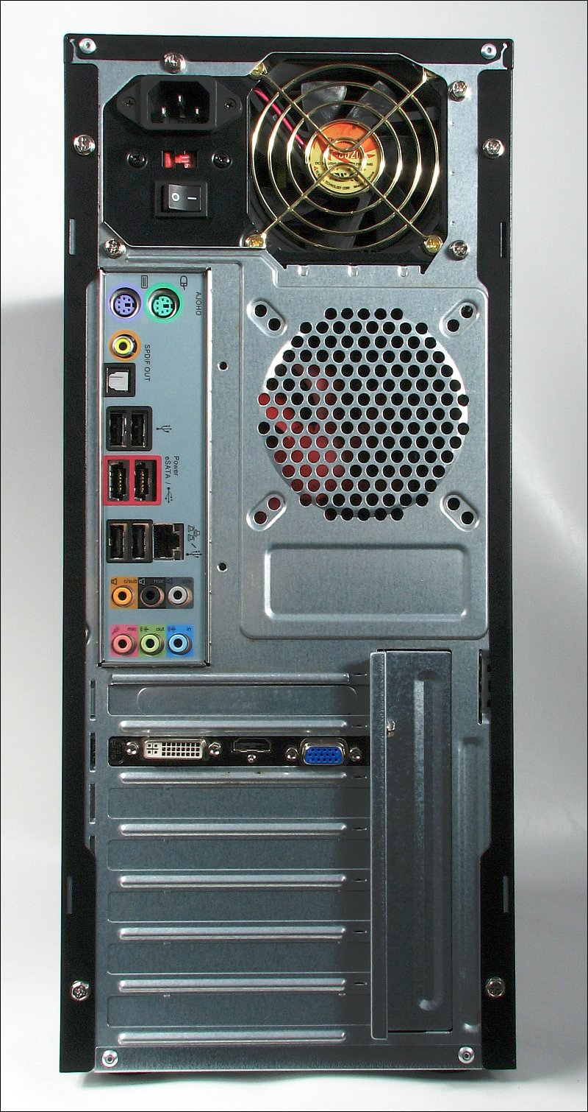
Power Cord
And switch
Mouse/keyboard
Interface
Ethernet interface
Usb ports
Audio
Input/output
Monitor
Interface

